Slide 1
Static Electricity
It’ll shock you!

Slide 2
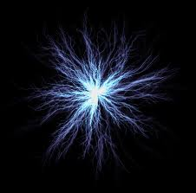
What is Electricity?
The movement of charges (electrons)
Can be passed (current)
or Stationary (static)
Electrostatics= the study
of static electricity

Slide 3
Differences?
Static Electricity:
charges build up on the surface of an object
Flow of charges last for very short periods of time
Unpredictability makes it difficult to use
Current Electricity:
Charges flow through a conductor in a controlled way
Flow is steady and follows a predictable path

Slide 4
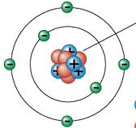
Electricity: The Facts
All objects are neutral until they are
charged to become positive or negative
If an object gains electrons (-) and possesses more electrons (-) than protons (+), it has an overall NEGATIVE charge
If an object loses electrons (-) and possesses more protons (+) than electrons (-), it has an overall POSITIVE charge
*An atom cannot GAIN protons to become positive
Trapped in the nucleus and do not move

Slide 5
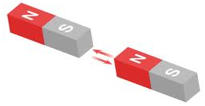
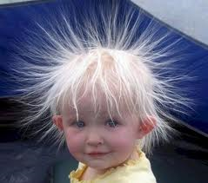
Law of Electrostatic Attraction
Opposite Charges attract each other
Ex. North/South ends on a magnet
Same / Like charges repel each other
Ex. Positively charged hairs
Charged objects (+ or -) can attract some neutral objects

Slide 6
Electrostatic Series
Acetate
Glass
Wool
Cat’s/Human hair
Ca, Mg, Pb
Silk
Al Zn
Cotton
Ebonite
Polyethylene
C, Cu,
Rubber
Sulfur
Pt, Au
A chart designed to indicate the likelihood of an object to gain or lose electrons
Materials like Acetate, Wool and hair are more likely to lose electrons and become positive
Materials like carbon, rubber and gold are more likely to pick up electrons

Slide 7
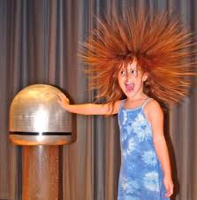
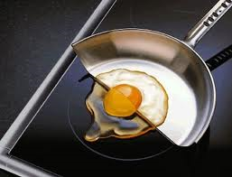
Charging Objects
Charging by Contact
Charging by friction
Charging by conduction
Charging by Induction
*Accompany each of the following slides with an electroscope diagram

Slide 8
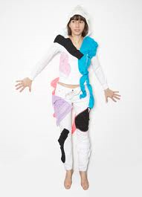
Friction
Rubbing two objects together, transferring electrons from one object to the other
(creating a charge imbalance)
Classic Examples:
Hair (+) and Rubber Balloon (-)
Socks (+) on a carpet (-)→ Door knob (conductor)
Static cling in the dryer→ fabric softener increases moisture to reduce static cling

Slide 9
Conduction
Once contacted, electrons transfer from negative object to positive object to balance out (minimize) the charge imbalance
Neutral Charged

Slide 10
Induction
Electrons move to one part of an object because it is in the electric force field of another
* Object altered does not touch the charged object
An object does not have to become completely positive or negative

Slide 11
Grounding Symbol to indicate →
Connecting an object to a large body, like Earth, that is capable of effectively removing an electric charge that an object might have
Ex. A tap (see text book pg. 475

Slide 12
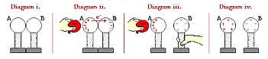
Two metal stands are mounted on insulating stands (grounded)
Presence of – charge induces e- to move from sphere A→B
Sphere B is separated from A
(contacting insulated stand)
Sphere A & B are now opposite charges

Slide 13
Comparing the Three
Using the example of rubbing your feet on a carpet and touching a door knob, let’s compare the three methods of charging
Friction: rubbing feet on the carpet gives your socks a – charged and the floor + charge
Conduction: Your foot has become charged by friction and therefore, your body has as well since they are connected (contact)
Induction: Electrons in your fingers tips brought close to the door knob repel the –’s, making the knob +

Slide 14
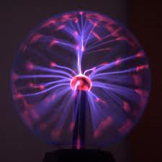
Static Discharge
Objects do not like to become charged
Neutralization of build-up of charge is known as a discharge
Once a build-up has been discharged, the objects return to a neutral state
A discharge is often visible and its size depends on the build up
Shock on a door knob Lightning

Slide 15
Lightning
Lightning is a natural process of the Earth and the atmosphere exchanging electric charges

Slide 16
Thunder cloud and ground are both neutral at first
Particles in the cloud separate (+ Top, - Bottom)
+ in ground are now closest to cloud and – are repelled downward
Charge build up causes a discharge (will strike the tallest object)

Slide 17
Conductors
Anything that allows electrons to move on or through it freely
Most metals are great conductors
Copper is the best example of a conductor as it has one valence electron that is easily shared → conducts the electricity
When considering air, the higher the moisture, the more conductive. Reducing the moisture creates a dry, insulated environment and the build up of static electricity

Slide 18
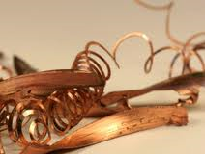
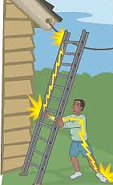
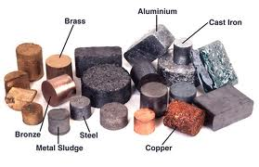
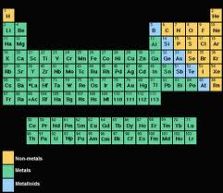
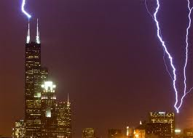
Examples of Conductors
Most turquoise elements

Slide 19
Insulators
Do the opposite of conductors → do not allow electrons to flow/move easily
Electrons are tightly bound together which prevents the flow of charges
Insulators are used to help protect us from the harmful effects of electricity
Ex. rubber case around copper wires (allows electricity to flow along the wire but you can touch the wire casing and not feel a shock

Slide 20
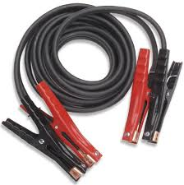
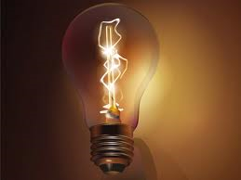
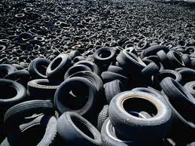
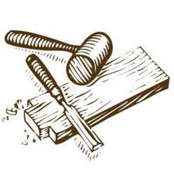
Examples of Insulators
Helps to keep your car grounded

Slide 21
Lightning Rods
Used to direct the flow of electrons away from buildings
Charged by induction (positive charges)
Attracts – ions that form in the air providing a path for the lightning
Electrons are carried around the building and into the ground by a heavy conductor

Slide 22
Electrostatic Precipitator
Used to remove 99.9% of solid and liquid contaminants from exhaust air (smoke stacks)
Harmful exhausts enter into a large grounded cylinder
Central conductor in the cylinder is highly charged, the same charge as the particles in the exhaust
Exhaust is repelled toward outer cylinder and once they collide, they discharge and collect into liquid/solid that can be removed

Slide 23
Electrostatic Spray Paint
Object being painted is given a + charge (by contact)
Paint particles become – charged as they pass through the nozzle of the spray gun
Helps to prevent paint waste
Faster more efficient
Creates smoother finish/ even surface coat

Slide 24
Antistatic Dryer Sheets (Bounce)
Used to prevent clothes from clinging to each other
Heat releases the wax on the dryer sheet which in turn, coats the clothes or fabric with a waxy lubricant
When clothes tumble, static charges cannot build up since the surface of the clothes is the same

Slide 26
Static in the Winter
Static electricity increases in the winter time because everything is so much more dry
Less moisture/ humidity in the air, the more insulating the air becomes which is likely to hold a charge and cause a build up rather than travel through the air
Ex. The Summer Balloon Experiment

Slide 27
Quiz Time!
Thursday, April 25th
Everything in this slideshow
Terminology (Electricity, Static Electricity, Conductor, Insulator, etc.)
Laws of Attraction and Repulsion (and applying them)
Identifying Charges
Charging Objects by Friction/Conduction/ Induction

Slide 28
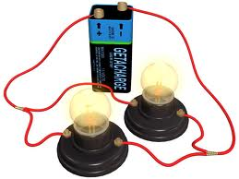
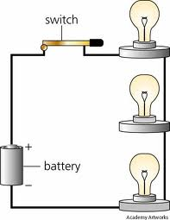
Look ahead to Current Electricity
The flow of electrons along a conductor
You’ll see words like:
Series
Parallel
Load
Energy source
Ampere
Ohm
Potential Difference
Electrical Resistance [and so on]

